Slide 1
Multiway Search Trees
11-<number>

Slide 2
m-way Search Trees
Definition: An m-way search tree, either is empty or satisfies the following properties:
  The root has at most m subtrees and has the following structures:
  n, A₀, (K₁, A₁), (K₂, A₂), …, (K_{n}, A_{n})
  where each A_{i}, 0 ≤ i ≤ n ≤ m, is a pointer to a subtree, and each K_{i}, 1 ≤ i ≤ n ≤ m, is a key value.
  (2) K_{i} < K_{i +1}, 1 ≤ i ≤ n-1
  (3) Let K₀ =-∞ and K_{n+1} =∞. All key values in the subtree A_{i} are less than K_{i +1} and greater than K_{i} , 0 ≤ i ≤ n
  (4) The subtrees A_{i}, 0 ≤ i ≤ n , are also m-way search trees.
11-<number>

Slide 3
A Three-way Search Tree
a
T
20, 40
b
c
d
10, 15
25, 30
45, 50
e
28
node | schematic format
a b c d e | 2, b, (20, c), (40, d) 2, 0, (10, 0), (15, 0) 2, 0, (25, e), (30, 0) 2, 0, (45, 0), (50, 0) 1, 0, (28, 0)
11-<number>

Slide 4
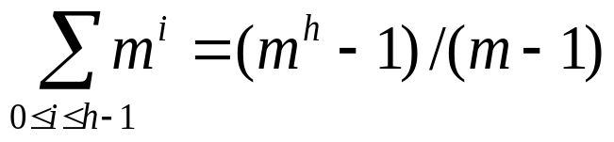
Searching an m-way Search Tree
Suppose to search an m-way search tree T for the key value x. By searching the keys of the root, we determine i such that K_{i} ≤ x < K_{i+1}.
  If x = K_{i}, the search is complete.
  If x ≠ K_{i}, x must be in a subtree A_{i} if x is in T.
  We proceed to search x in subtree A_{i} and continue the search until we find x or determine that x is not in T.
Maximum number of nodes in a tree of degree m and height h:
Maximum number of keys: m^{h} − 1.
11-<number>

Slide 5
Searching an m-way Search Tree
E0.K= -MAXKEY;
for(*p=root, p; p=Ai)
{
Let p have format n, A0, (E1, A1)….(En, An);
En+1.K= MAXKEY;
Determine i such that Ei.K<= x <Ei+1.K;
if(x==Ei.K) return Ei; /* x in the tree */
}
/* x not in the tree */
return NULL;
11-<number>

Slide 6
B-trees (1)
Definition: A B-tree of order m is an m-way search tree that either is empty or satisfies the following properties:
2 ≤ # children of root ≤ m
All nodes other than the root node and external nodes:
⎡m/2⎤ ≤ # children ≤ m
(3) All external nodes are at the same level.
2-3 tree is a B-tree of order 3 and 2-3-4 tree is a B-tree of order 4.
All B-trees of order 2 are full binary trees.

Slide 7
2-3 tree: B-tree of order 3
A
40
B
C
2-3-4 tree: B-tree of order 4
10
20
80
50
10
70
80
5
7
8
30
40
60
75
85
90
92
11-<number>

Slide 8
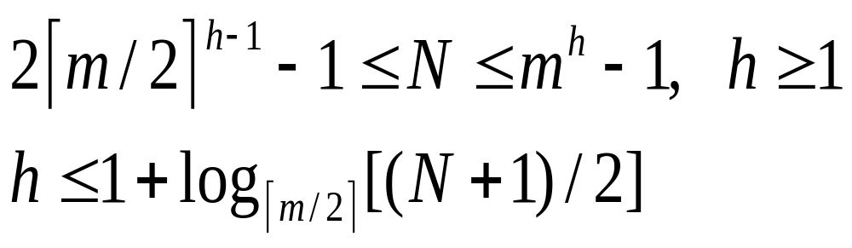
B-trees (2)
N: # of keys in a B-tree of order m and height h
  Reason: Root has at least 2 children, each other node has at least ⎡m/2⎤ children.
11-<number>

Slide 9
B-trees (2)
N: # of keys in a B-tree of order m and height h
  Reason: Root has at least 2 children, each other node has at least ⎡m/2⎤ children.
For example, a B-tree of order m=200 with # of keys N ≤ 2×10⁶−2 will have h ≤ 3.
11-<number>

